Slide 1

A two day work shop on designing the phase locked loop using sky130nm -techology

Slide 2
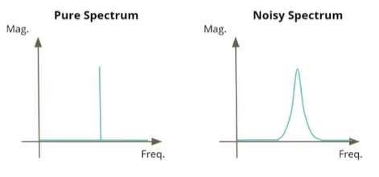
PLL(phase locked loops):
A pll is basically a control system which maintains its output signal in phase with input reference signal which is
coming from an external sourse(quartz crystal)
The main idea of this workshop is to design a PLL for clock signal where the output signal should not have any
phase and frequency distortions with respect to reference signal
Here you can see the frequency spectrum of the nosiy ad pure signals, where the noise spectrum having
responses at other frequencies also.

Slide 3
PLL components:
The main design components of the PLL are:
phase frequency detector
charge pump
low pass filter
voltage controlled oscillator
frequency divider
The phase frequency detector finds the difference between the reference signal and the output signal and it will enable or disable the up or down signals correspondingle which were connected to the charge pump through “D” flip flops
The AND operation to the outputs of “D” flip flops are given to the CLR(clear) input pin of the flip flop in order to make sure the output of “ D “ flip flop as zero when both outputs are same
charge pump is one of the main component in the design which is used to produce the constant voltage to the input of the VCO in order to generate the output signal with the desired frequency
The response of the VCO is linear relation with input voltage
In our design we can control the VCO externally also by using the Multiplexer where the control signal
could be to enable or disable the charge pump.

Slide 4
FREQUENCY PHASE DETECTOR
CHARGE PUMP VOLTAGE
GENERATIONS
FREQUENCY DIVIDER
1
up
VDD
D
Output
Vref
D
Output
Negative Clk
up
clr
charge pump
voltage to VCO
AND
Gate
clk
down
Negative Clk
1
clr
D
Output
down
R
Cx
GND
Vout
C
Negative Clk
GND
GND

Slide 5
Responses of the charge PUMP
If the average active time of the up signal is more
than the down signal then the voltage across the charge
pump is
if the average active time of the down signal is more
than the up signal then the voltage across the charge
pump is
Voltage(V)
Voltage(V)
Time(T)
Time(T)
The main disadvantage of the charge pump is, it will get charged with leakage current also, without the presence
of up and down signals , we can improve its performance by additional circuits(including the current mirrors)

Slide 6
while desigining the PHASE FREQUENCY
DETECTOR we need to be very careful about the
dead zone which is the very small difference
between the vref and vout signals
in the phase frequency detector the down signal
will get activated if leading the ref signal
in the same manner the up signal will get
activated if the out signal is lagging the ref signal
Here in the charge pump design we have added
the RC series circuit in order to make the system
stable
As we know
I=dq/dt
and Q=CV
so I=d(CV)/dT
Hence
dV/dT=I/C
so total voltage across the charge pump will be
equal to V= integration from time 0 to t(till the
operation of the of the charge pump) “t” can be
more than the time period.
ref low
ref low
UP=0
DOWN=1
UP=0
DOWN=0
UP=1
DOWN=0
out low
out low
STATE DIAGRAM

Slide 7
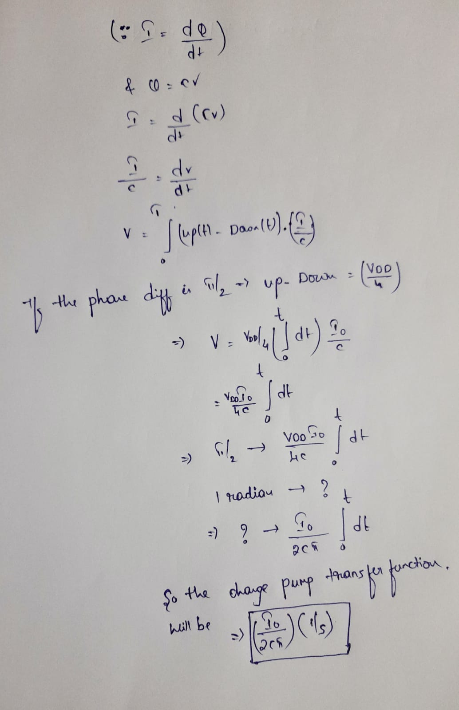
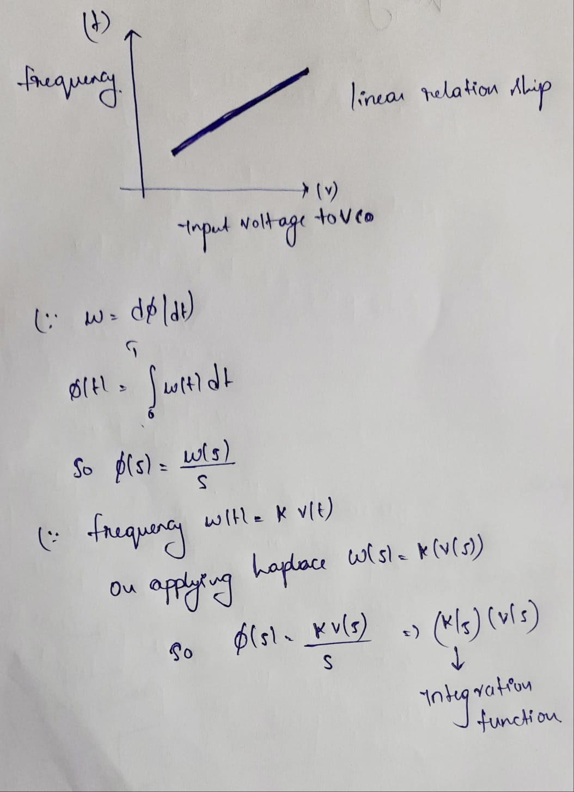
Here on observing the transfer function
of charge pump with only a single
capacitor it includes a integrator in its T.F
And we know the transfer function of
VCO also had an integrator
so on observing the complete open
loop transfer function we will have S^2
in its denomination which explicitly says
the presence of oscillations(poles lies on
the y axis)means system is not completly
stable so in order to improve the stability
of the system we are placing the Series
RC combination at the
The Cx value should be =C/10 to
achieve the higher stability.

Slide 8
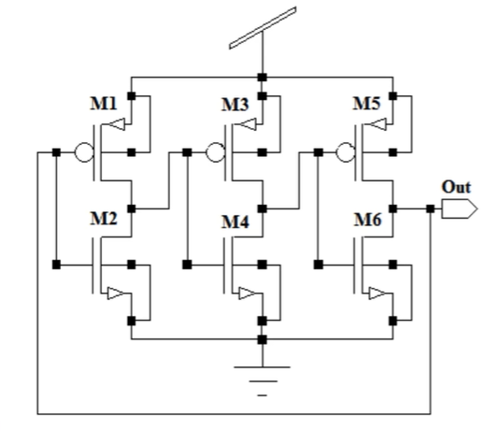
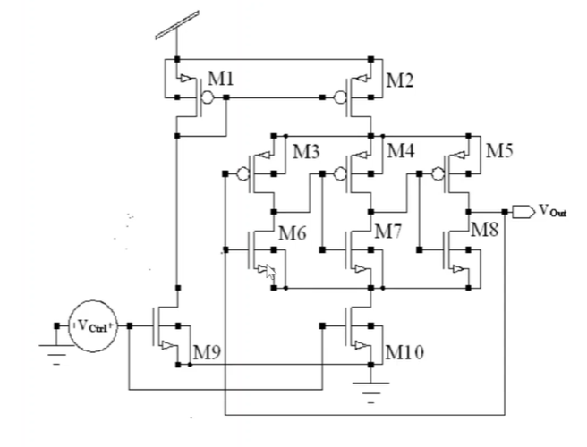
VOLTAGE CONTROLLED OSCILLATOR(VCO)
The time period of the ring oscillator with 3 inverters
is 6(delay of inverter)
By using the starving mechanism we are generating the
output frequency
Initially the charge pump voltage is used to control the
current through the curent mirrors as the Ring oscillator
is connected in the series circuit of the current mirror, the
current through the ring oscillator determines the outout
generated frequency
current
mirror circuit
Ring Oscillator

Slide 9
Important definations related to PLL:
Lock in range: once the PLL is locked, it can track the frequency change in the incoming signals. the range of frequencies over which the PLL can maintain the lock with incoming signal is called the lock-in range
Capture range: the frequency range the PLL is able to lock-in from an unlocked state is called capture range
Settling time: The time taken to attain the lock state from an unlocked state

Slide 10
TOOL SETUP
npsice software for transistor level circuit simulation
command to install ngspice: sudo apt-get install ngspice
ngspice directly simulates the circuit file and plots the outputs.
we need to download the sky130 primitive libraries considering the fact that PLL is designed for sky130nm mode
to run the file type: ngspice <circuit_file_name>
magic software is for layout design and parasitics extraction
here we can modify and we can also extract the parasitics, GDS write features
we need the technology file for 130nm mode
to run the file type: magic -T <technology_file_from_pdk> <circuit_file_name>

Slide 11
DEVELOPMENT FLOW
specifications: mentioned by the client
spice-circuit level design: designing the circuit which is satisfying the specification mentioned by the client
pre layout simulations:checking the subcircuit level outputs and interconnecting them
layout development: developing the layout by satisfying the design rules
parasitics extraction: in order to achieve the original behaviour of the design we need to simulate the design with parasitics , so here we are extracting the parasitics
post layout simulation: checking out design performance over the designed layout
Note: we need to do a lot of changes in the individual steps in order to meet the specifications

Slide 12
PDK’S AND SPECIFICATIONS
All the informations about the trasistor like(area,configurations,parameter) are available in the PDK kit
The pdk kit is just like ibis file in PCB level simulations
The characteristics of the transistor are available in this kit
The pdk contains:
io-input-output
pr-primitives(spice): we are using this in our PLL design
sc-standard cells
hd-high density
hs-high speed
lp-low power
hdll- high density low leakage
specifications:
corner -’TT’ (Typical-Typical) which
corresponds to doping
corner -’FS’- fast nmos and slow pmos
supply voltage -1.8v
room temparature
VCO mode(where the control voltage is
given directly to the VCO pin)
The range of input frequencies for which
the PLL should work Fmin=5MHz;
Fmax=12.5MHz
Multiplier- 8X
jitter-20ns(which means the time difference
between the signals).
PVT

Slide 13
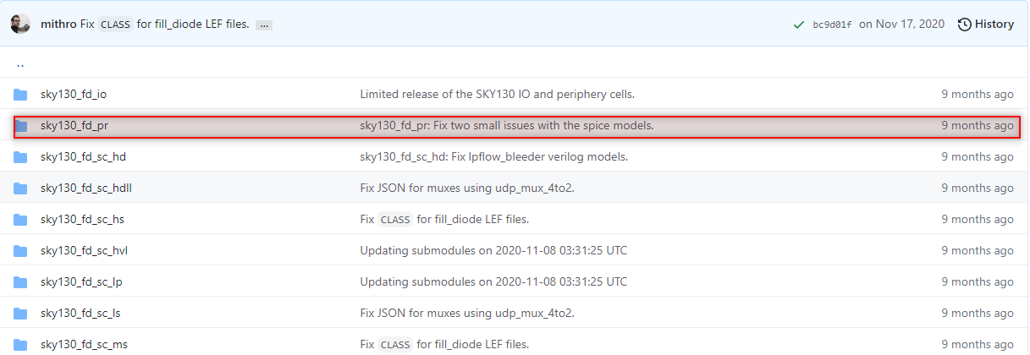
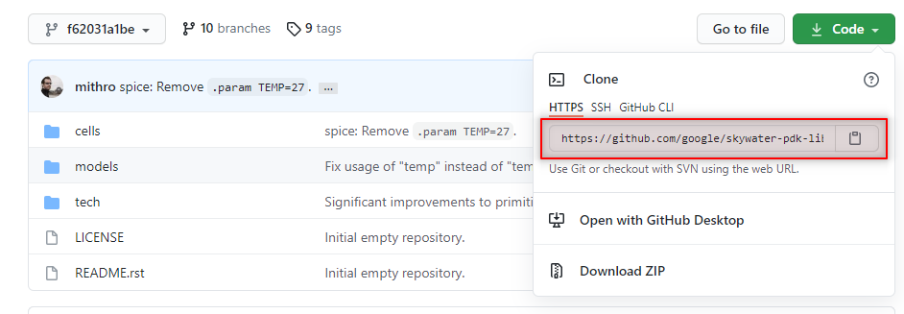
Tools,dependicies installation
To install ngspice type: sudo apt-get install ngspice on your terminal in ubuntu.
After installing the ngspice we need to download the sky130nm primitives which we are using in PLL design.
The link for downloading the files is https://github.com/google/skywater-pdk/tree/main/libraries

Slide 14
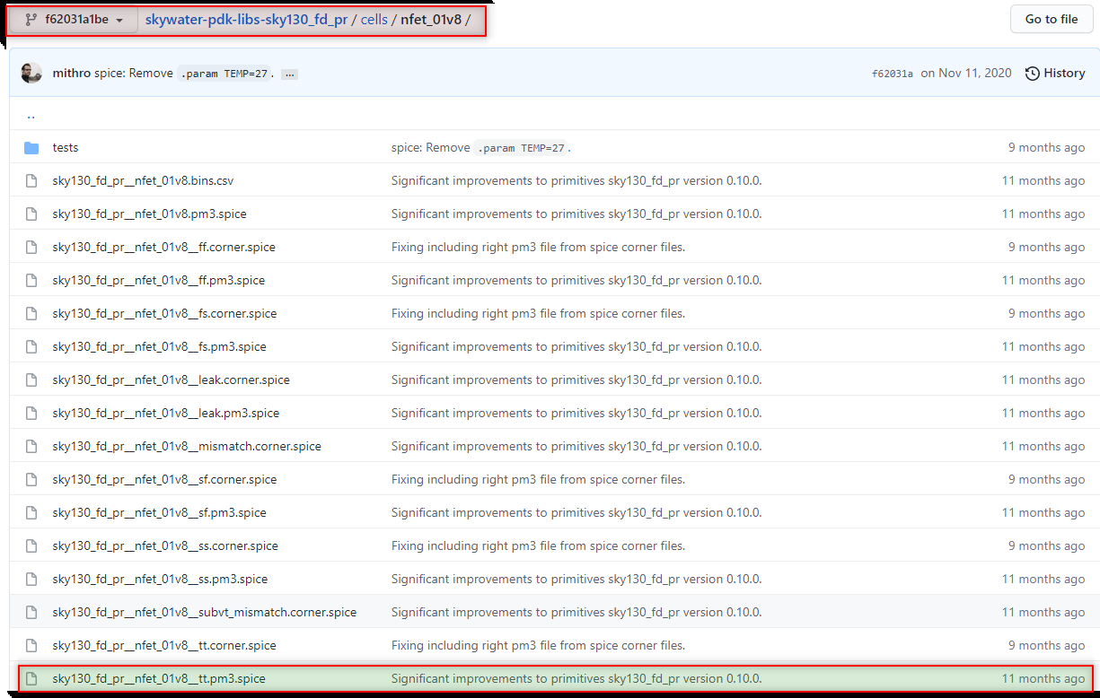
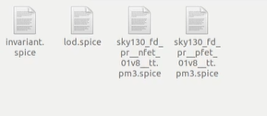
Finally we need the spice file for the nfet
which is available in the: cells/nfet_01v8
similarly find the pm3.spice files for the
pfet also
Finally we need all these files for our
design purpose
We can also combine all these files and
in one file by using the .include command.
For magic installation:
we can clone the magic repository by typing the command git clone git://opencircuitdesign.com/magic in the
terminal and install all the dependicies as well, Download the technology file also.

Slide 15
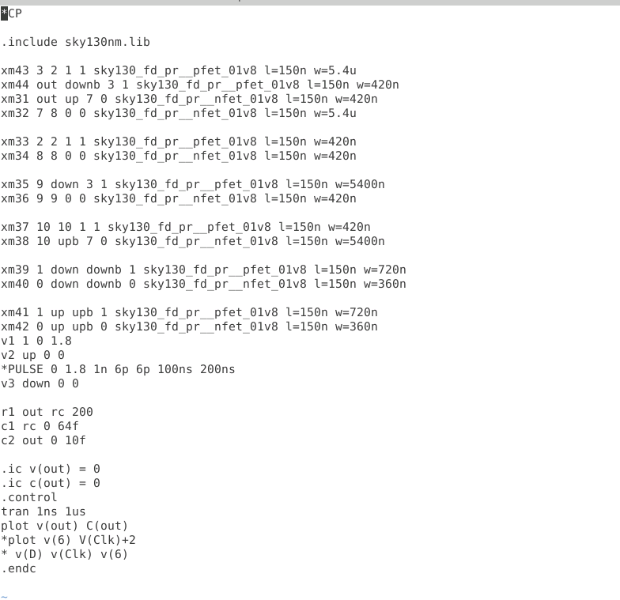
spice files
code snippet
A spice file is just an extension with .cir or .spice
we can create the spice file by using the command touch filename.cir
in spice file first line is always a comment
( eg: *filename)
always include the library file in the .cir file
here we can define the new components
for example (here the nmos is defined as
xm1 3 2 1 1 sky130_fd_pr_pfet_01v8 l=150n, w=420n)
we need to write the model name which is found in
library files and we need to write the terminal pins which are (drain,gate,source,body) width and length of the mosfet here we are working on 130nm technology so there will be some minimul limits as well for width and lengths

Slide 16
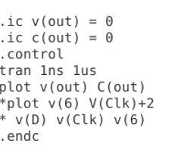
Important blocks in the code
Here .ic indicates the initial conditions
The .control block is used to keep the simulation instructions
the tran instruction is used to run the transcient analysis with the specified run time
plot is used to plot the signals respectively
finally we need to end the control block

Slide 17
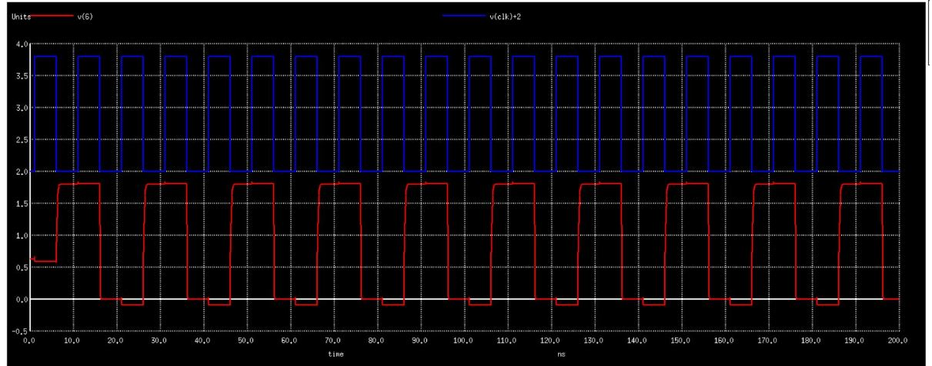
simulating the FD circuit
After successfully writing the circuit file for the frequency divider we can simulate it using the command
ngspice filename.cir on the terminal
frequency divider output : red is the output signal and blue is the input signal

Slide 18
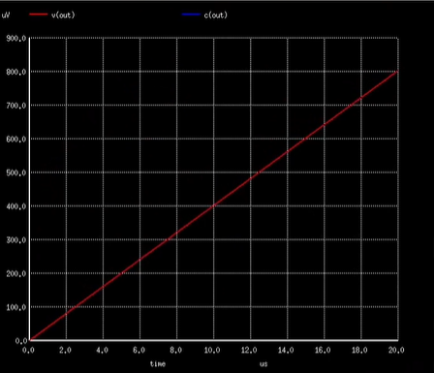
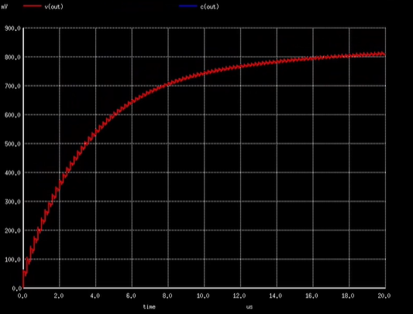
charge pump leakage voltage
here we can see the charge pump voltage which is generated due to the leakage current.
here the voltage is in the range of uv and the time is in us
charge pump responce when the up signal is given
with improved stability and adding the current mirrors to the
circuit
here the voltage is in the range of uv and the time is in
us

Slide 19
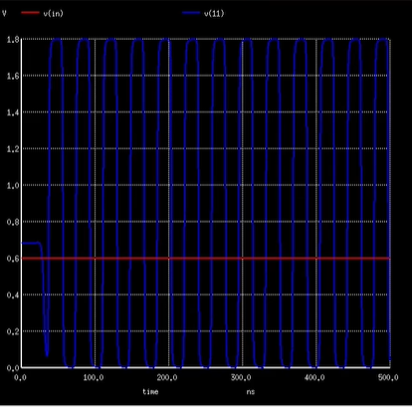
VCO simulated results
VCO full swing outputs for the reference voltage of 0.6V
In order to get the full swing output we need to add an inverter at the ouput of the VCO
As we know the VCO output frequency depends on the input voltage of the VCO

Slide 20
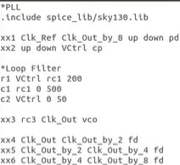
combining all the circuits
we can combine all the subcircuits in to the single file and we can run it
initially we need to instantiate the subcircuits and then we also need to define the definations
of the subcircuits even
we need to give the signal names also after
instantiating the sub circuits which will match
to the signals in the subckt defination
After attaching the subcircuits end the individual code block with .ends subckt name.

Slide 21
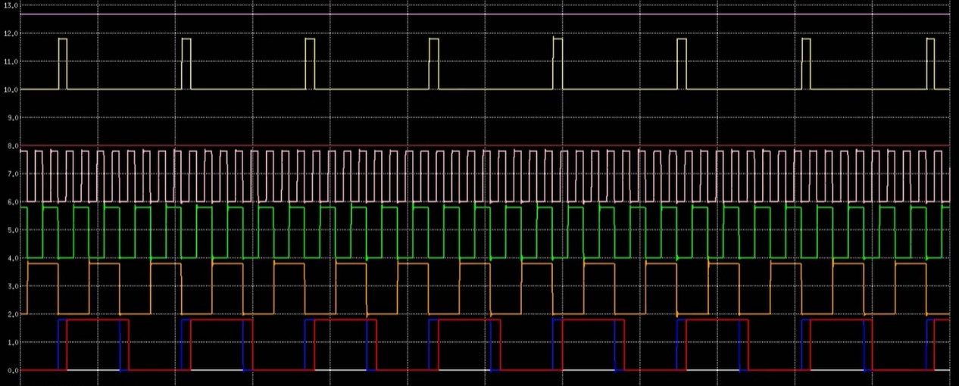
simulation results
down signal
up signal
clk_out_by_2
clk_ref
clk_out_by_8

Slide 22

Trouble shooting steps:
Always debud the individual components
if any of the output signal is not generating check the intermediate connections
if the expected output is not generating check for like(net name, capitilization of units etc..)
if the difference in phase is reduced to few “ns”(dead zone) if the phase detector is not able to detect then it could lead the stability issue
check for charging or discharging of the charge pump
we can also check the transfer function stability by using RH criteria
main objective is to have the poles of the system to the left side

Slide 23
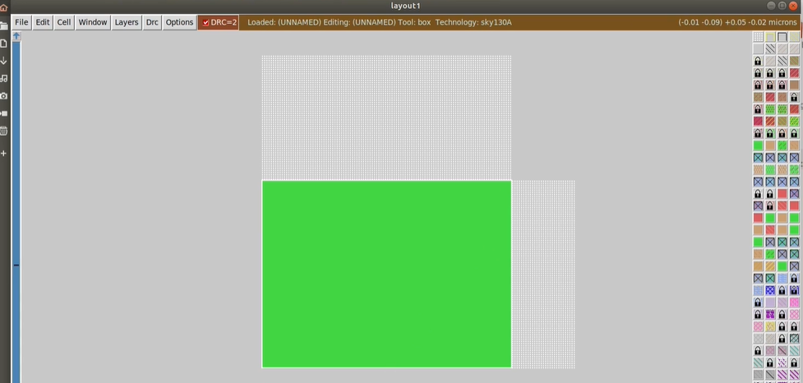
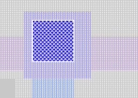
layout design
Magic is the tool which is used for layout design and parasitic extraction
we can open the layout tool by entering the command magic- T sky130A.tech
we can even select the area on which we are going to draw our layout by selecting the region and we can also fill the materials required for the transistor to fill out by selecting the materials on the right.
In order to connect the components in other layers we need to add vias
we need to meet the design rule checkup’s in order to have a perfect design
we can also copy the design by drawing the box around it and by pressing the A buttoon to select it and move the cursor to the desired location and then press C button to place there.
M button is used to move the design
via

Slide 24
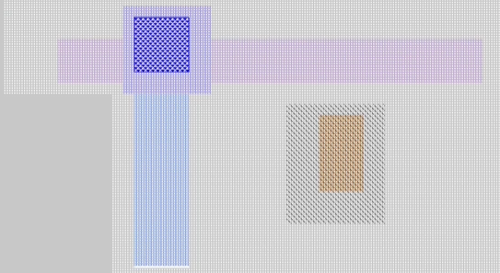
Errors
if we get the whitish DRC errors then there is a chances that layer or the interconnect is small or very big
we need to satisfy all the design rule checks in order to obtain the desired results
like some of the interconnects may not carry the high density currents because of the interconnect size
there is a possibility of crosstalk or might be signal integrity issues or mismatch in the characteristic impedance
we need to solve all the errors which we are getting in order to make the design work properly and we need to
give improvements as early as possible before fabricated design testing
we need to satisfy the DC IR results also to make work the design with stable power supply
ports and labels
label means it is justa name for the interconnect
we can create the label by drawing the box around the edge of the
interconnect we can name it by entering the command label out
we can also make it a port by drawing the box around the labelled
interconnect and by typing the command port make.
we need to have ports for extracting the parasitics
via
interconnect
label

Slide 25
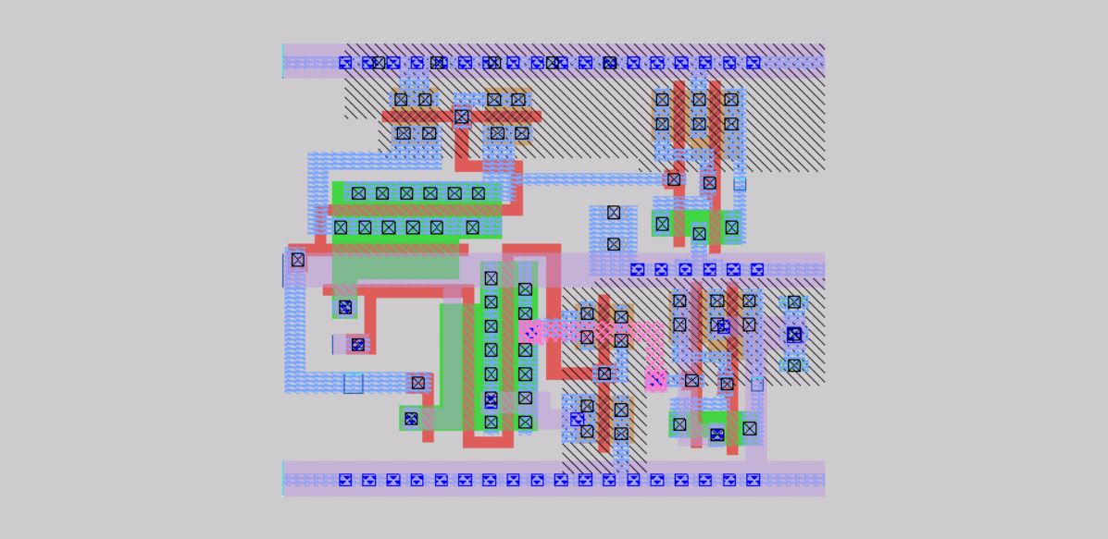
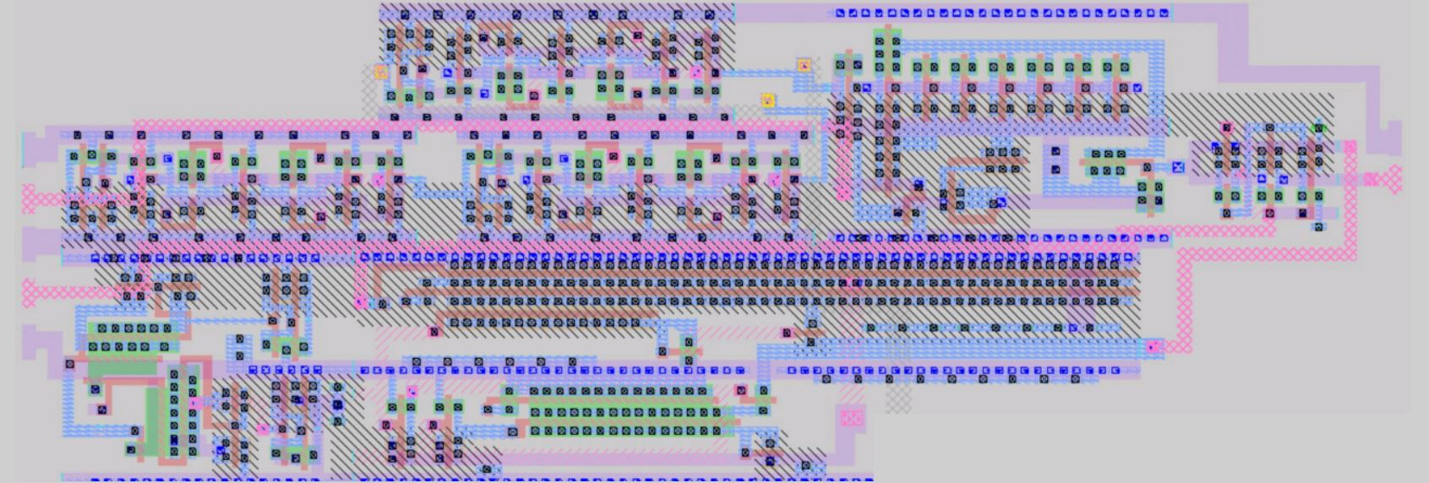
checking the layout in magic
type the command magic-T sky130A.tech filename.mag to view the layout
phase frequency detector layout
PLL layout

Slide 26
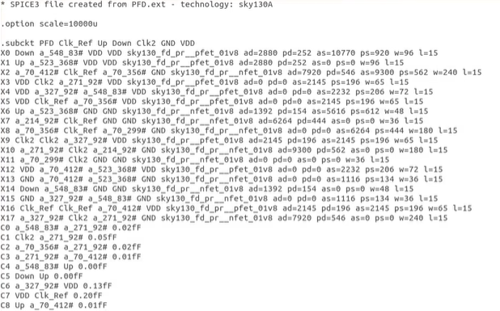
ports extraction
type the command magic -T sky130A.tech filename.mag, now the layout will appear
now press the I button to select the whole design and type extract all this will extract in to the .ext file
now we need to convert the .ext file in to the spice file by typing ext2spice cthresh 0 rthresh 0, here the threshold values are given if any amount of capacitive or resistive effect is above there then extract them
This the results which we are getting with additional parameters lists like area, peri etc of transistors, capacitance effects and the scale is also mentioned which is wrong by default, so we need to change the scale

Slide 27
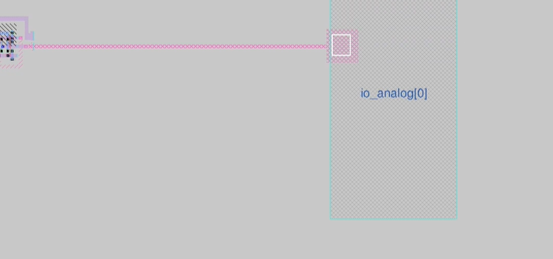
post layout simulation, combining the layouts and TAPE OUT
After all the preprocessing steps and combining all the sub circuits and extracted ports data in to the sigle .cir file we need to keep the simulation which is the real time behaviour of the design
we can also combine all the layouts by interconnecting them using the interconnects
Tape out means preparing our design and sending it to the fabrication.
we need to have the peripherals, memory, power supply pads etc...
so for all the preparatory steps we have predefined soc which is given by efabless caravel
where the designer has to bother about placing the design over the soc and all the peripherals are interconnected over it
the design coule be placed on the user project area and the connection pins could be made by
drawing the interconnects
we need to be careful about the ESD which is one
harm to the design, ESD diodes could be also placed
in the design
connecting the VCO(supply pin ) to the analog pin

Slide 28
Acknowledgement
Thank you Mr. Kunal Ghosh, co-founder VSD, for this wonderful 2-day workshop.
Special thanks to Ms. Lakshmi S, for guiding the workshop and sharing the great knowledge

